Slide 1


Micro Network (INDIA) Private Limited
IT Infrastructure | Solutions | Services | Support | Implementation
ISO 9001:2015 COMPANY
703 - MANJUSHA BUILDING, 57 - NEHRU PLACE, NEW DELHI – 110019
T:- +91-11-41395338, 41395392 W:- https://micronetwork.co.in
E:- contact@micronetwork.co.in

Slide 2
HOMEPAGE
About us
Core Vision
Technical alliances
Our Services
CONTACT
Our Clients
History

Slide 3

Established in 1997 We've Served the industry globally from past 22 years by delivering complete IT Infrastructure | Service | Solutions | Implementation, enabling our customer/clients to increase there efficiency and productivity to transform their business
THE ABOUT
About
Micro Network

Slide 4

1000 CR Turnover
To cross more over than 1000 CR annually.
Vision
and Mission
International Level Presence
Worldwide OEM sales, service, support & implementation provider.
To be the IT infrastructure partner of choice for
esteem customers by collaboratively providing right
and quality solutions and transforming technology
into business opportunities
Supply chain management
Become the distributor of topmost OEM in India.
One Stop IT Hub
Complete IT solutions under 1 roof.

Slide 5




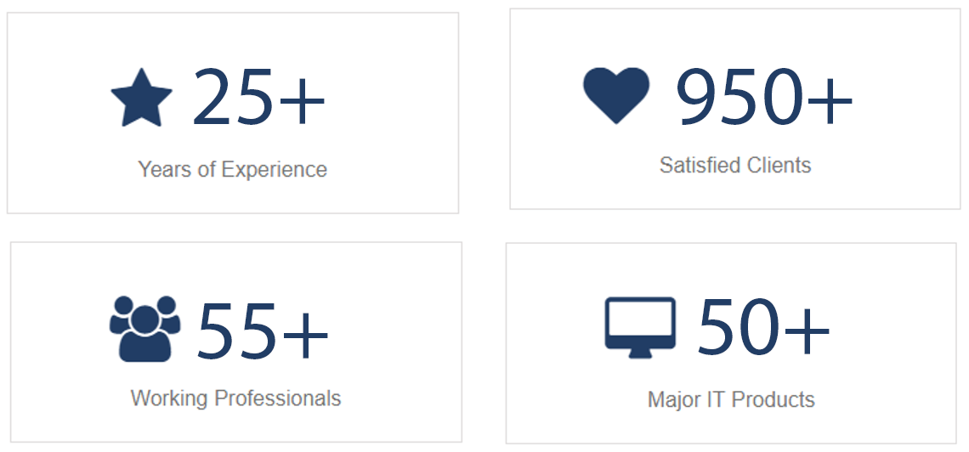

A Little Bit Of History

Slide 6


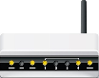


IT INFRASTRUCTURE
IT MANAGED SERVICES
Complete IT Solutions at very competitive price
Instant IT Managed Services
IT SUPPORT
IT CONSULTANCY
High Tech IT Support via professional IT Expert
Freely Discuss your IT infrastructure with us

Slide 7

Data Center
Solution
Access Control
Networking
Solution
Automation Solution
Security & Surveillance Solution
Server Solution
Digital Document Imaging Solution

Slide 8







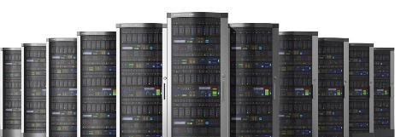
01
Implementation
02
Relocation
Data Center Solution
03
Consolidation
04
Virtualization
05
DR Site

Slide 9
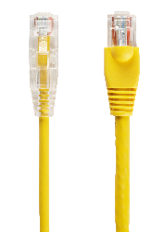
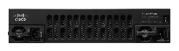
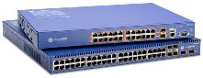
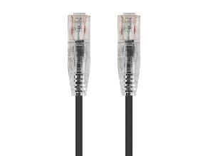






Networking Solutions
ACTIVE NETWORKING
NETWORK SECURITY
PASSIVE NETWORKING
Switching
Routing
Firewall IDS / IPS
Penetration Testing
Network Assessment
Network Audit.
Core Network Security
Communication Security
Perimeter Security
End Point Security
Cable laying for Data & Voice
Rack Installation & Labelling
UTP Cable Termination at I/O / Patch Panel
Penta Scanning
Rack Installation & Dressing

Slide 10
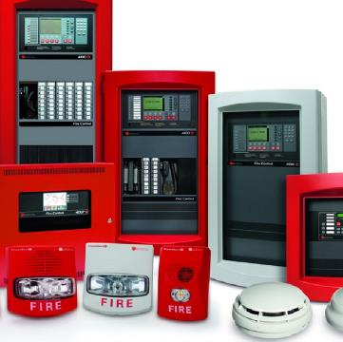



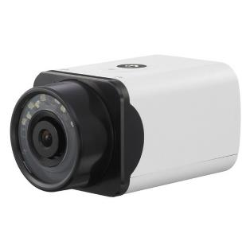


Security & Surveillance Solution
Fire Alarm System
Intrusion Detection System
CCTV Surveillance System

Slide 11
Security & Surveillance Solution - CCTV
City Surveillance Solution
BFSI Surveillance Solutions
Transportation – City Bus, Airport Solutions and Highway Monitoring
Medical CCTV Surveillance System
Hospitality Security and Surveillance Solutions

Slide 12
Security & Surveillance Solution - CCTV
IP CCTV Solutions
HDCVI CCTV Solutions
Intrusion Detection System
CCTV Surveillance System

Slide 13
Security & Surveillance Solution - CCTV
Video Wall
Remote Monitoring
360 Degree View
180 Degree View

Slide 14




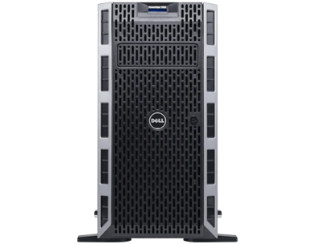
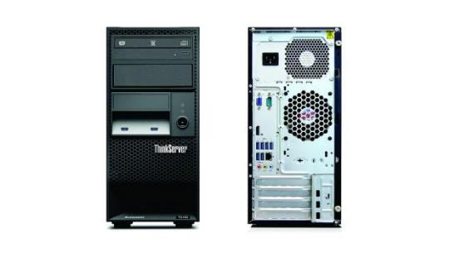
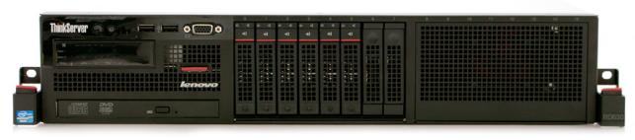
Server Solution
Rack Server
Tower Server

Slide 15
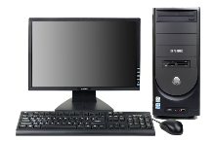
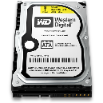
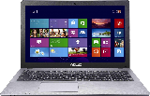
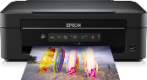
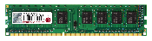








Computing Solution
From complete OEM to assembled computing solution
We have each and everything as per your
Requirement.
Laptop
Desktop
Accessories

Slide 16









MICROSOFT
Microsoft Windows Server 2016, 2012
Microsoft SQL Server
Microsoft Windows Operating System
Microsoft Office 365, Professional Plus,
Standard
Other Software
Quick heal
Kaspersky
Norton
McAfee
SOFTWARE
SOLUTION
ADOBE
Photoshop
Coral draw
Illustrator
Dreamweaver

Slide 17
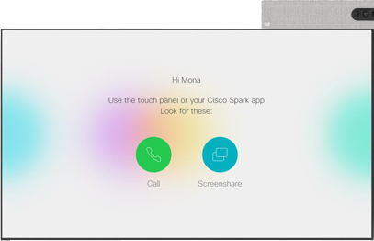
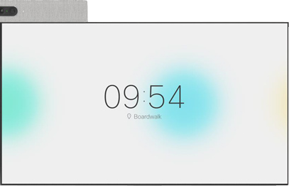
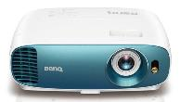





AV Solutions
Video Conferencing
Audio Conferencing
Voice Communication
VOIP Solution
Contact Center Solution

Slide 18



Voice Communication
01
IP Communication
02
Contact Center Solution
03
EPABX Solution
04
END Point Solution

Slide 19




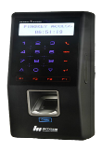
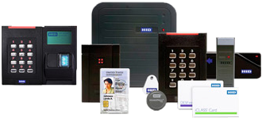

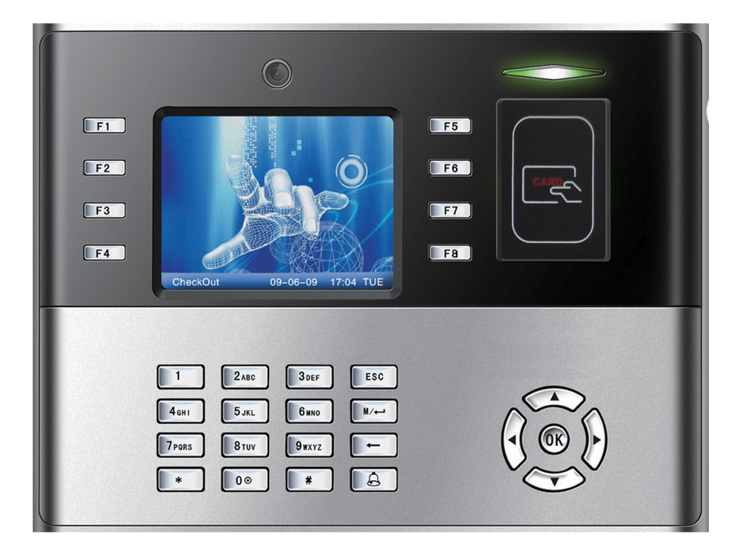

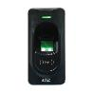
Access Control & Bio-Metric
01
Time Management
02
Attendance Management
03
Visitor Management System
Bollards
Boom Barriers
Door Controllers
Readers

Slide 20

Document Digitalization
Document Management Software
Document Scanners
Customized Software Development

Slide 21
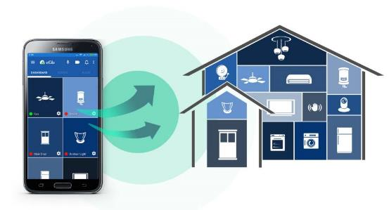
Automation Solution
Interior Automation
Exterior Automation
Industrial Automation
Home Automation

Slide 22
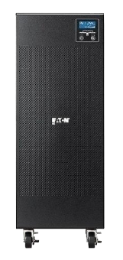






Power Backup Solution
Online UPS
Offline UPS
Batteries
Installation
1
2
3
4

Slide 23

1
GREEN ENERGY
Environment
Complete Green Energy Setup from Micro Network India to preserve energy & uses of natural resources for efficient cost cutting in your energy expenses

Slide 24
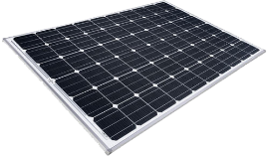
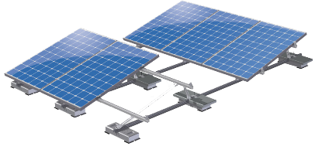

2
Solar Rooftop Panel
3
Solar Power Plant Evaluation
4
Large Scale Solar Power Plant

Slide 25

IT Managed Services
1
Cloud Integration Service
2
Networking Services
3
AV Integration
4
System Implementation
5
IT Support Services
6
Annual Maintenance Contracts
7
Server Implementation

Slide 26
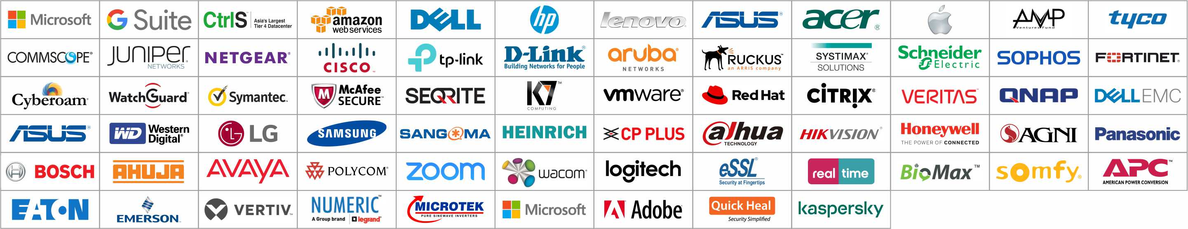
Partnering With……….

Slide 27




















Our Clients

Slide 28























Our Clients

Slide 29
THANKS
FOR WATCHING
HAVE A
QUESTION?

Slide 30
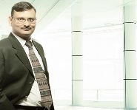
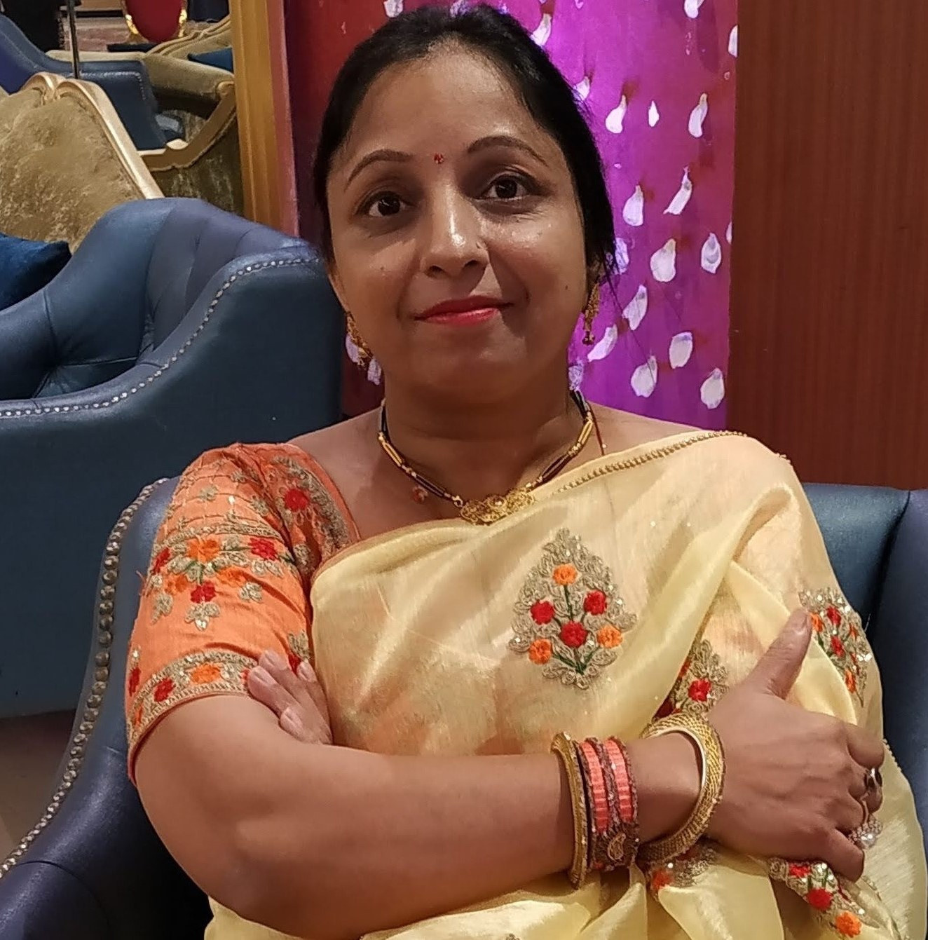
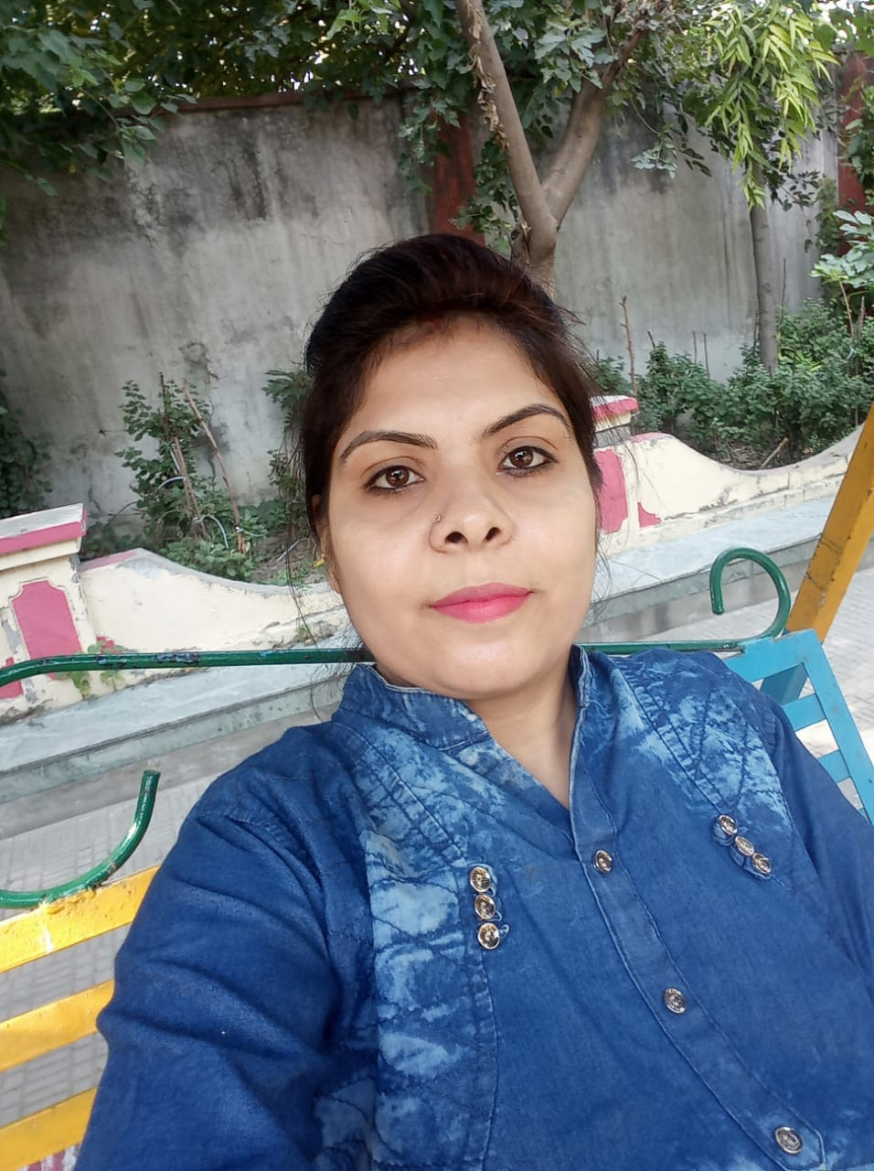



Meet our Team
AKASH DEEP JAIN
BABITA JAIN
DIRECTOR
DIRECTOR
SHALINI WADHWA
KAJAL KAUSHIK
KUNAL KAUSHIK
RUBY KASHYAP
MANAGER - IST
BUSINESS DEVELOPMENT
BUSINESS DEVELOPMENT
ADMINISTRATION DEPT.
+91-9810-352-127
Shalini.wadhwa@micronetwork.co.in
+91-9810-312-170
Kajal.Kaushik@micronetwork.co.in
+91-9811-362-127
Kunal.kaushik@micronetowork.co.in
+91-8287-944-751
admin@micronetwork.co.in

